Slide 1

Life Expectancy- Our World in Data

Slide 2
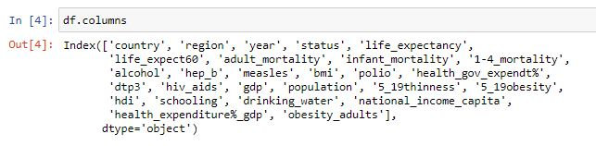
Dataset:
This dataset tracks many features of a nation for a period of 15 years, from 2000 – 2015 to determine which factors play the most responsible role for deciding the life expectancy of its citizens. This will help many developing nations to take steps which will allow them to tackle the most important factors that are responsible for low life expectancy. This project is trying to determine an efficient way of improving the life expectancy of many developing nations.
The dataset was collected from various sources such as WHO repository, Kaggle and other websites and merged.
Variables in the dataset:

Slide 3
* life_expectancy: Life expectancy at birth (in years)
* adult_mortality: Adult Mortality Rates of both sexes (probability of dying between 15 and 60 years per 1000 population)
* infant_mortality: Infant mortality rate (Death rate up to age 1)
* 1-4_mortality: Age 1-4 mortality rate (Death rate, age 1-4)
* alcohol: Alcohol, recorded per capita (15+) consumption (in litres of pure alcohol)
* hep_b: Hepatitis B (HepB) immunization coverage among 1-year-olds (%)
* measles: Measles - number of reported cases per 1000 population
* bmi: Average BMI of entire population
* polio: Polio (Pol3) immunization coverage among 1-year-olds (%)
* health_gov_expendt%: General government expenditure on health as a percentage of total government expenditure (%)
* dtp3: Diphtheria tetanus toxoid and pertussis (DTP3) immunization coverage among 1-year-olds (%)
* hiv_aids: Deaths per 1 000 live births HIV/AIDS (0-4 years)
* gdp: GDP per capita (in USD)
* population: Population Total
* 5_9thinness: Age 5-9 thinness
* 5_9obesity: Age 5-9 obesity
* hdi: Human Development Index in terms of income composition of resources
* schooling: Schooling, Number of years
* drinking_water: Population using at least basic drinking-water services
* national_income_capita: Gross national income per capita (PPP int. $)
* health_expenditure%_gdp: Current health expenditure (CHE) as percentage of gross domestic product (GDP)
* obesity_adults: Obesity among adults(%)

Slide 4
Faulty Data:
Ranges for every column for deciding Inexplicit Nulls based on WHO Statistics 2015 official report:
* life_expectancy: Life expectancy at birth (in years): Range ~ (35, 87)
* adult_mortality: Adult Mortality Rates of both sexes(probability of dying between 15 and 60 years per 1000 population): Range ~ (36, 634)
* infant_mortality: Infant mortality rate (Death rate up to age 1): Range ~ (1.6, 165)
* 1-4_mortality: Age 1-4 mortality rate (Death rate, age 1-4): Range ~ (2, 330)
* hep_b: Hepatitis B (HepB) immunization coverage among 1-year-olds (%): Range ~ (20, 99)
* health_gov_expendt%: General government expenditure on health as a percentage of total government expenditure (%): Range ~ (0.1, 28)
* dtp3: Diphtheria tetanus toxoid and pertussis (DTP3) immunization coverage among 1-year-olds (%): Range ~ (3, 99)
Note: Similarly, all the columns were checked for faulty data, no faulty data present.

Slide 5
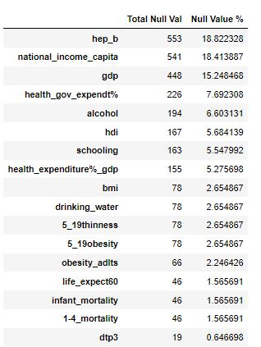
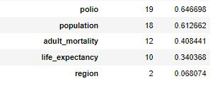
Missing Data:

Slide 6
Filling the Missing Data:
To fill missing values, 3-step process was followed:
Some missing values for columns such as Population, GDP, Health expenditure % were filled manually from the internet.
Categorical variables, region and status were one-hot encoded.
The remaining missing values were imputed using the MICE algorithm.

Slide 7

Model Fitting:
Goal is to fit the linear regression model on the dataset to predict life expectancy and to determine which factors play the most responsible role for deciding the life expectancy. Following assumptions need to by satisfied before fitting linear regression model:
There should be a linear relationship between target variable and predictor variables.
There should be no correlation between the residual (error) terms. Absence of this phenomenon is known as Autocorrelation.
The independent variables should not be correlated. Absence of this phenomenon is known as multicollinearity.
The error terms must have constant variance. This phenomenon is known as homoskedasticity. The presence of non-constant variance is referred to heteroskedasticity.
The error terms must be normally distributed.

Slide 8
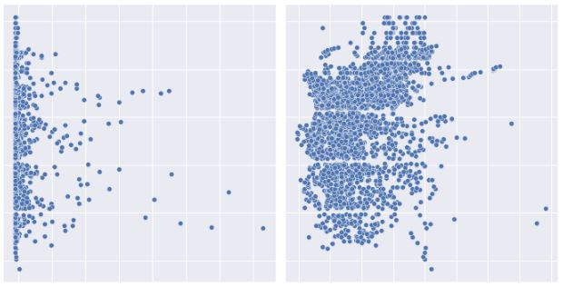
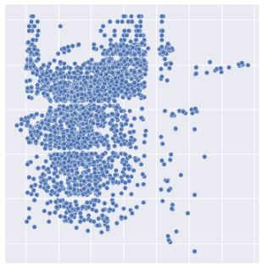
Checking Linearity : Linear Regression requires the predictor and the target variable to be linear. Pairplots help us to determine which variables are linearly related with the target variable. The predictor variables which do not exhibit linear relation with the target variable are hepB, alcohol and health_expenditure%_gdp and so are dropped.
Alcohol
HepB
health_expenditure%_gdp

Slide 9
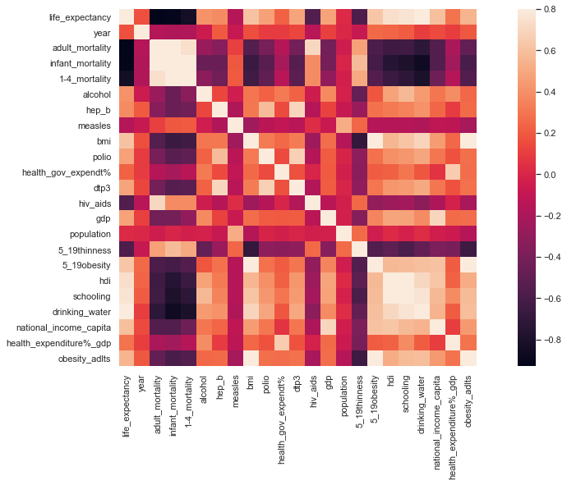
Multicollinearity : Some of the variables in the dataset are highly correlated with each other as it can be seen from the correlation heatmap. In order to overcome the problem of multicollinearity in the model, VIF test is conducted. Based on the VIF scores, the following variables have been removed from the model: obesity_adlts, infant mortality.

Slide 10
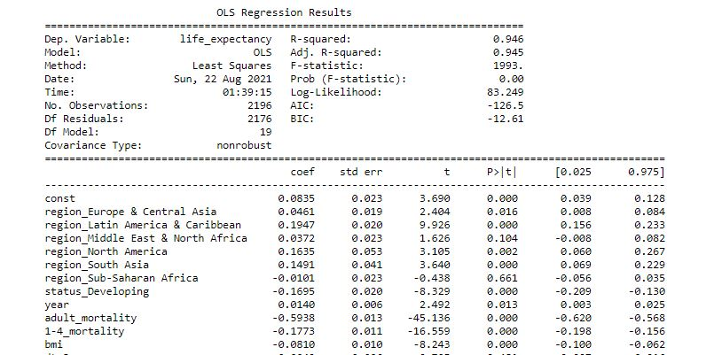
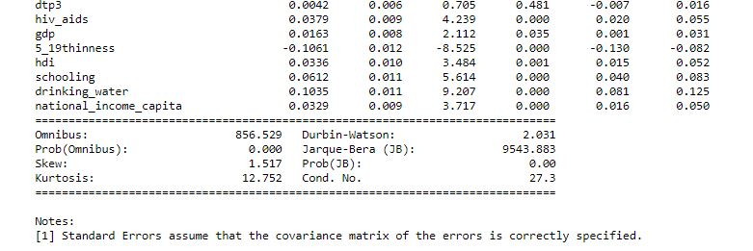
Model Summary:

Slide 11
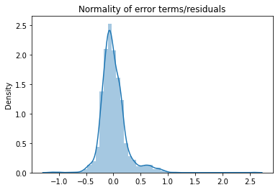
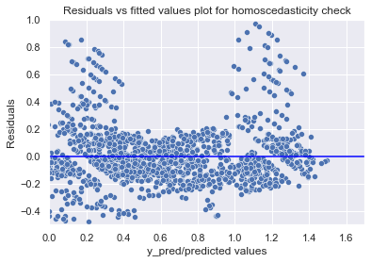
Normality of Residuals: The error terms are clearly normally distributed.
No Heteroscedasticity:
As the plot shows no discernible pattern, the error terms are homoscedastic in nature.
No Autocorrelation: Checked the value for Durbin-Watson statistic which came close to 2. thus, autocorrelation is absent

Slide 12
Model Evaluation:
R squared: 0.9425
Adj R squared: 0.9410
Mean Sq error: 0.0576
RMSE: 0.2400

Slide 13
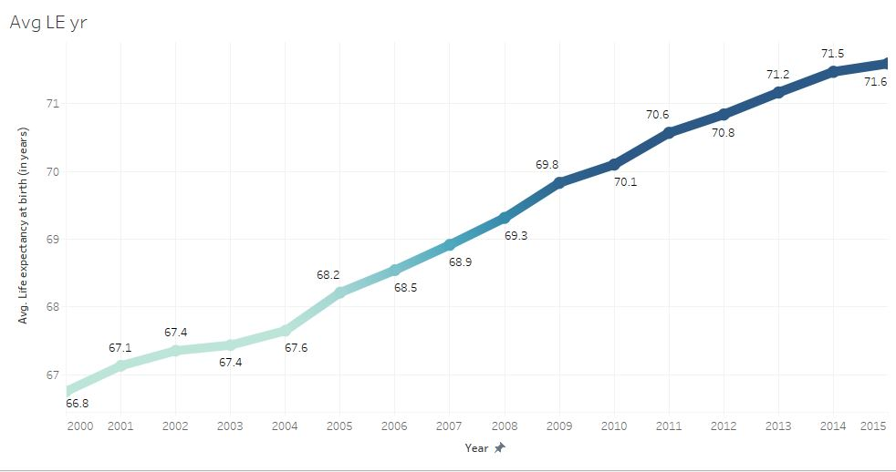
Conclusions:
Factors that were effecting the life expectancy most were, Region, Status, mortality rates (adult mortality rate, 1-4 mortality rate), basic drinking water services, BMI.
Average life expectancy of world increased by 5 years since 2000.

Slide 14
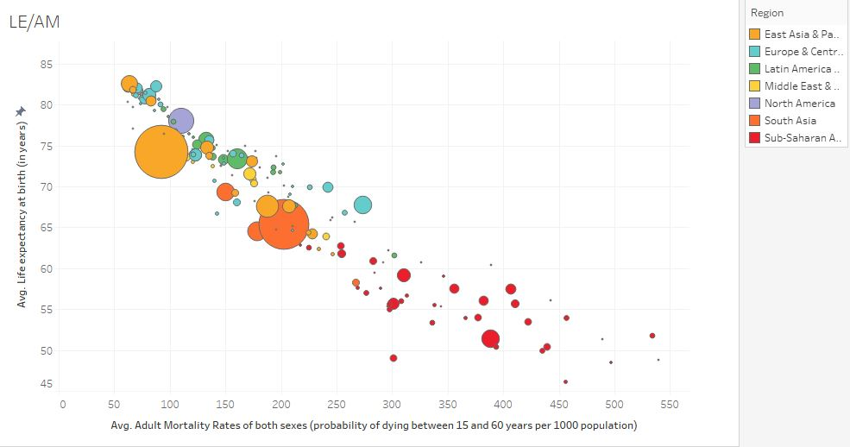
Plot shows Life Expectancy’ dependence on adult mortality and region

Slide 15
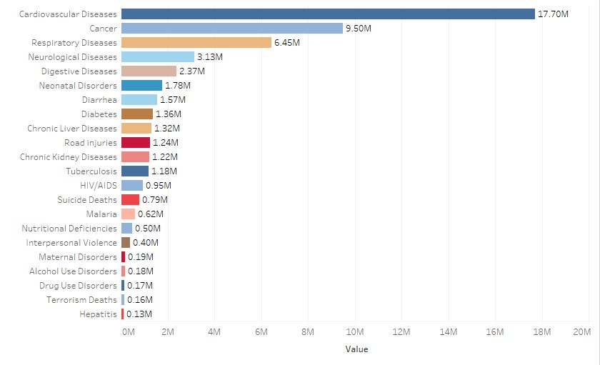
Annual number of deaths due to various causes (year- 2015)

Slide 16
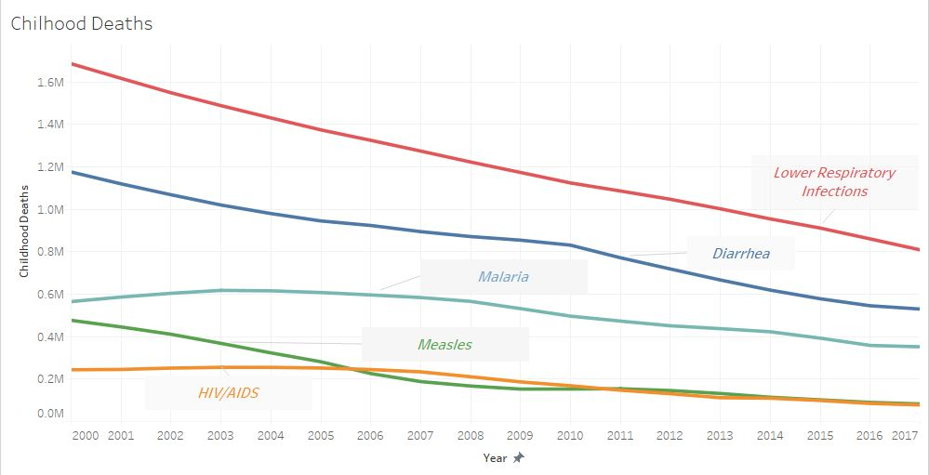
Childhood deaths from 5 most lethal infectious diseases from 2000-2017

